Slide 1


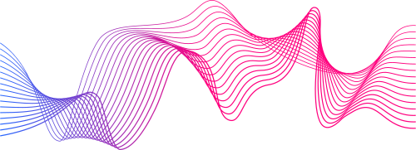
PRESENTED TO
MULTIMODAL
TRANSLATION
PROJECT
Digital Egypt Pioneers Initiative DEPI
Company
AST
track
Mircosoft Machine Learning Engineer
PRESENTED BY
Nassar Khaled Mahmoud
Abdelrahman Moustafa Attia
Omar Medhat Mohamed
Habeba Mostafa Desoky
Carol Maged Victor
Integrated Translation System

Slide 2
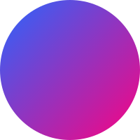
1
INTRODUCTION
5
CHAT BOT
Agenda
2
6
IMAGE-TO-TEXT CONVERSION
SYSTEM OVERVIEW
3
TOOLS USED
7
DEPLOYMENT ON AZURE
4
TRANSLATION MODEL
8
STREAMLIT INTERFACE

Slide 3
9
RESULTS
Agenda
10
CHALLENGES
13
QUESTIONS
11
FUTURE ENHANCEMENTS
14
TRY IT
12
CONCLUSION

Slide 4


Introduction
With the increasing globalization, there is a growing need for efficient and accurate translation tools.
Existing solutions often focus on only one aspect, such as text translation, without integrating image, document, and real-time communication support.
Back to Agenda

Slide 5
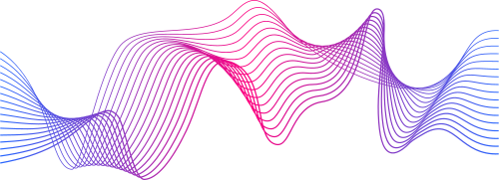
Back to Agenda
System Overview
Core Components:
Translation Model: Provides context-aware, accurate translations across multiple languages.
Image-to-Text Conversion: Extracts text from images and translates it.
Chat Interface: Real-time translation of conversations for interactive communication.
PDF Reader: Uploads and translates documents like PDFs.
Technology Stack:
Natural Language Processing (NLP) for translation.
Azure Machine Learning for model deployment, storage, and scaling.
OCR (Optical Character Recognition) for extracting text from images and documents.
Streamlit for a user-friendly, interactive interface.

Slide 6
MIND MAP
part of image
to text
with cnn model
DATASET
PREPROCESSING
VIZALIZATION
MODELING
part of Translation
DATASET
Part of Chat
DATASET
VIZUALIZATION
PROJECT
PIPLINE
PREPROCESSING
MODELING
MODELING
AZURE
STREAMLIT

Slide 7
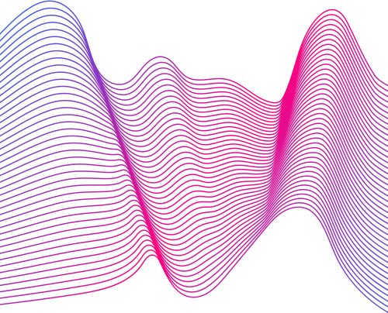
Azure
AZURE MACHINE LEARNING
Streamlit
TOOlS
INTERFACE WITH USER
Colab
we used in our project
TO RUN THE NOTE BOOK
kaggle
SOME DATASETS
Back to Agenda

Slide 8
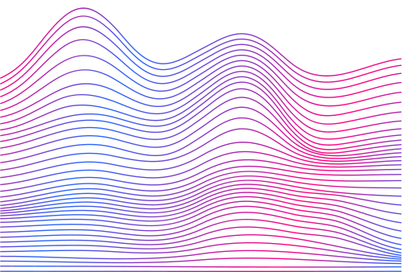
Back to Agenda
chat bot
Challenges:
Understanding diverse user queries: Users express themselves in various ways, making it difficult for the chatbot to handle every possible input.
Maintaining context: Keeping track of the conversation’s flow when users switch topics or ask follow-up questions.
Natural language complexity: Human language includes nuances, slang, and ambiguity that are difficult for the AI to interpret correctly

Slide 9
chat bot
Model Architecture
Follows a transformer architecture. This architecture consists of:
Encoder-Decoder Layers: It uses self-attention mechanisms to process input sequences, capturing long-range dependencies and context from user queries.
Pre-training and Fine-tuning: The model is pre-trained on a datasets to understand language patterns and fine-tuned to specialize in chatbot-specific tasks.
Attention Mechanisms: The transformer uses multi-head attention to focus on relevant parts of the input, making it highly efficient in understanding context and generating coherent responses.

Slide 10
chat bot
Text Cleaning:
Remove unnecessary characters, punctuation, or irrelevant symbols that may confuse the model.
Standardize text (e.g., convert to lowercase) for uniformity.
Tokenization:
Break down the input text into smaller units called tokens (words or subwords), which the model can process. GPT models typically use byte pair encoding (BPE) to handle this.
Handling Missing or Incomplete Data:
Remove or fill in missing values to avoid gaps in training that could negatively affect the model’s performance.
Stop Word Removal
Lemmatization:
Convert words to their root form to reduce variations (e.g., “running” becomes “run”) and help the model generalize across different forms of a word.
Handling Special Tokens:
Add special tokens for specific tasks like start-of-sequence (<s>) or end-of-sequence (</s>) markers to assist the model in structuring its responses.

Slide 11
Back to Agenda
Transaltion model
Why Translation?
Address language barriers between English and Arabic.
Use machine learning for accurate and efficient translation.
Challenges:
Complex sentence structures in both languages.
Different syntax and grammar rules.

Slide 12
Back to Agenda
Transaltion model
Model Architecture
Seq2Seq Model:
Encoder-Decoder architecture.
Encoder processes input sequence (English sentence).
Decoder generates output sequence (Arabic sentence).
Why LSTM?
Handles long-term dependencies effectively.
Suitable for language translation tasks.

Slide 13
Back to Agenda
Transaltion model
Data Preprocessing
Steps Involved:
Tokenization of English and Arabic sentences.
Padding sequences for uniform input size.
Creating word-to-index mappings for both languages.
Key Libraries:
TensorFlow/Keras for model building.
NLTK or similar libraries for tokenization.

Slide 14
Transaltion model
Back to Agenda
Model Training
Training Setup:
Input: Padded English sentences.
Output: Corresponding Arabic sentences.
Loss Function: Categorical crossentropy.
Optimizer: Adam for efficient convergence.
Metrics: Accuracy and loss per epoch.

Slide 15
Back to Agenda
Transaltion model
Challenges & Solutions
Data Scarcity: Using smaller datasets effectively.
Handling Grammar Rules: Tuning hyperparameters to capture language intricacies.
Improvements: Adding attention mechanisms or transformer models for better accuracy (Helsinki-NLP/opus-mt-en-ar).

Slide 16
Back to Agenda
Image-to-Text Conversion model
Overview:
The image-to-text conversion feature enables the extraction of textual content from images, enhancing the translation system's versatility.
Utilizes Optical Character Recognition (OCR) technology for accurate text extraction.
Text

Slide 17
Back to Agenda
Image-to-Text Conversion
Steps that follow:
1- import necssary libraries
2-Reading and Prepare the data : image and labels
3- split data into train ,validate and test
4-Creating generatore By ImageDataGenerators :to make data augmenation
5-Modeling with CNN model
6- Train the model and test it by computer vision

Slide 18
Back to Agenda
Image-to-Text Conversion
function that used :
1- directory_to_df : to get and prepare data as DataFrame
2-read_images: to get the image from the path
3- show_images: to show the image by matplot
4-load_model : to load the model after saving it
5-convert_2_gray: to convert rgb”3d” into 1d
6- binarization:applies Otsu's binarization to the grayscale image, producing a binary image
7-dilate:performs morphological dilation on the binary image
8-find_rect:identifies bounding rectangles in the binary image and sorting
9-extract:uses the aforementioned techniques to extract characters from the image

Slide 19
Back to Agenda
Azure Deployment
We used Azure Machine Learning Studio for deploying the models. We created a Workspace and uploaded the notebooks for model training. During this process, we encountered an issue with obtaining GPU from the compute service in Azure, which caused the training process to take a long time. As a result, we had to train the models outside of Azure .
After completing the training, we set up Azure Blob Storage to upload the trained models. Additionally, we attempted to design a Pipeline in Azure Machine Learning Studio to automate the steps of processing and deployment, aiming to streamline the process of training and deployment.

Slide 20
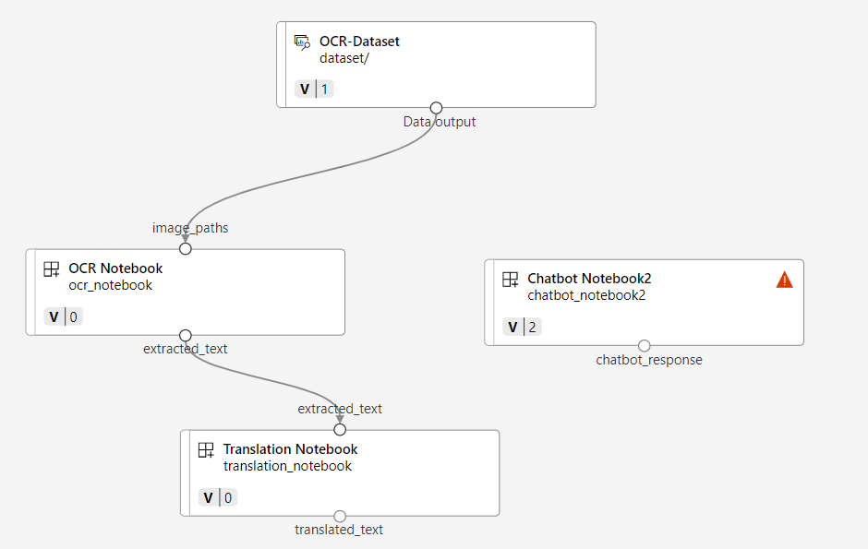
Azure Deployment
pipline design:
It starts with the OCR-Dataset, which feeds data into the OCR Notebook.
The OCR Notebook processes the data (image paths) and produces extracted text.
The extracted text is then passed to the Translation Notebook for further processing.
Finally, the output of the translation could be used in the Chatbot Notebook

Slide 21
Back to Agenda
Streamlit
Purpose of Streamlit:
Provides an interactive and user-friendly interface for the translation system.
Allows users to easily interact with the translation model, upload images, PDFs, and have real-time chat translations.
Features Integrated with Streamlit:
Translation Interface: Simple UI where users can input text, upload images, or documents for translation.
Real-Time Chat Interface: Users can engage in conversations and get real-time translations.
Document and Image Upload: Upload PDFs and images directly to the system for text extraction and translation.

Slide 22
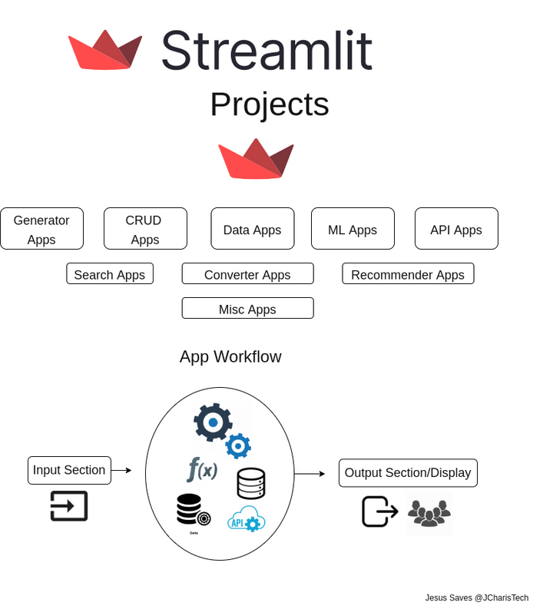
Back to Agenda
Streamlit
Benefits of Using Streamlit:
Ease of Use: Non-technical users can interact with complex models through an intuitive graphical interface.
Rapid Deployment: Quick to develop and deploy changes in real-time.
Visual Feedback: Displays translation results instantly, enhancing user experience.
Azure Integration:
Streamlit is connected to Azure ML models, ensuring scalability and handling large workloads efficiently.

Slide 23
Streamlit
Project Architecture
A mind map is a diagram that organises information visually. It shows the relationships between pieces of a whole project .
input text
can just input the text and translate it
Translation
samples image
Upload image
STREAMLIT APP
extract text
two option like try or uplpad
Image to text
Pdf reader
after extract the text it will translate
chat

Slide 24
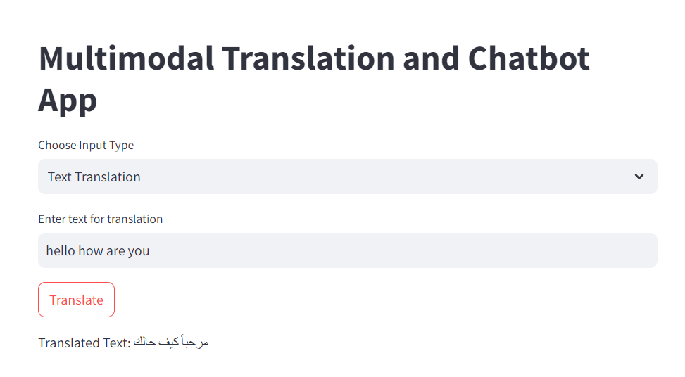
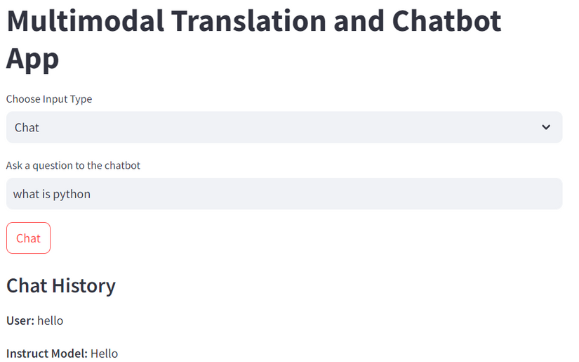
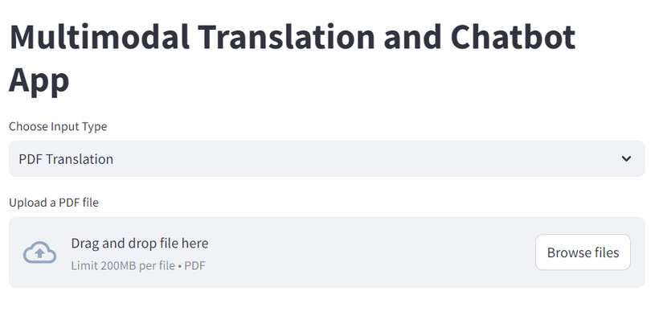
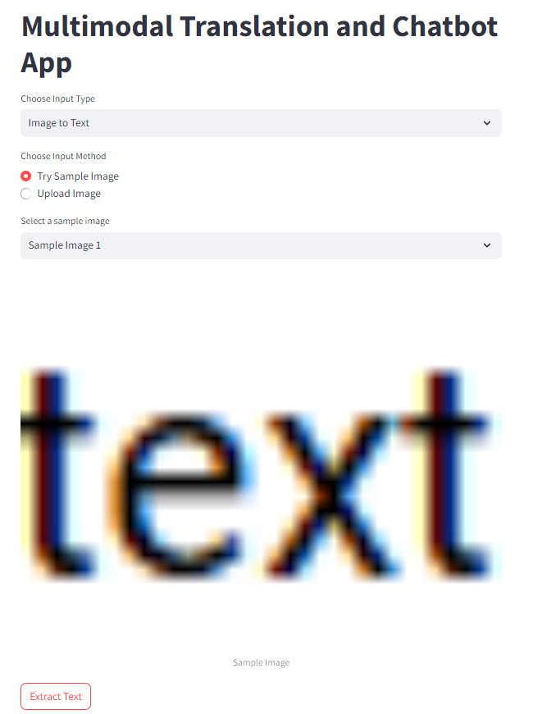
Interface

Slide 25
Dataset | difficult to get dataset suitable for the model that can fit the gpu time
Storage | the models that saved is very large so we get the storage in azure
compute | the compute need long time also having Gpu
streamlit | storage of githup is low
Challenges
that we faced and solved.
Back to Agenda

Slide 26
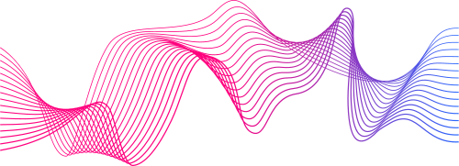
Future Enhancements
make more feature like video transcripting and translatation it
make voice response that can convert text to voice
use azure features that more
publish the application on streamlit global
Back to Agenda

Slide 27
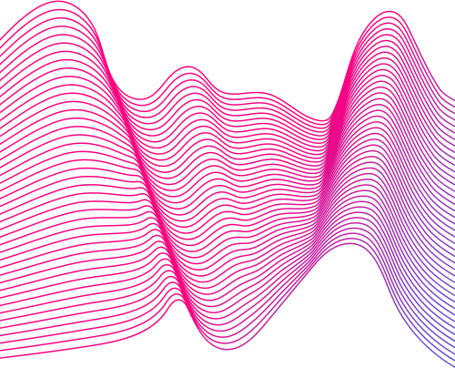
Conclusion
Integrated Translation System
Use of Advanced Technology
Real-World Applications

Slide 28
Question & Answer
Any Question !

Slide 29
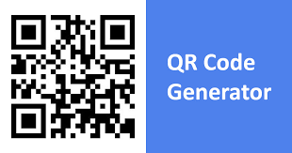
Try it !
by
SOON
link
or
scan it!

Slide 30
Thanks for your time
need your Feedback
Nassar Khaled Mahmoud
Abdelrahman Moustafa Attia
Omar Medhat Mohamed
Habeba Mostafa Desoky
Carol Maged Victor

